Slide 1
Agents
Rachel Cavill

Slide 2
Who read chapter 1 of Russell and Norvig?
What is an agent?
Notes:
Including the annoying Office Assistant 2003

Slide 3

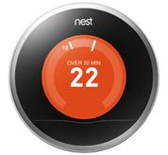
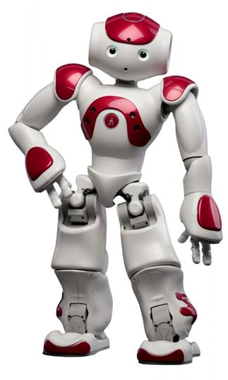

What is an agent?
An agent is anything that can be viewed as perceiving its environment through sensors and acting upon that environment through actuators
An agent operates autonomously
Examples?
Agents include humans, robots, softbots, thermostats, etc.
Notes:
Including the annoying Office Assistant 2003

Slide 4
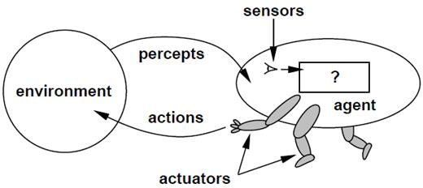
Agents
An agent is an entity that perceives and acts We focus on designing rational agents Abstractly, an agent is a function from perception history to an action:
[f: P* → A]

Slide 5
Example of agents
Human agent:
Sensors?
eyes, ears, and other organs
Actuators?
hands, legs, mouth, and other body parts for actuators
Robotic agent:
Sensors?
cameras and infrared range finders;
Actuators
various motors

Slide 6
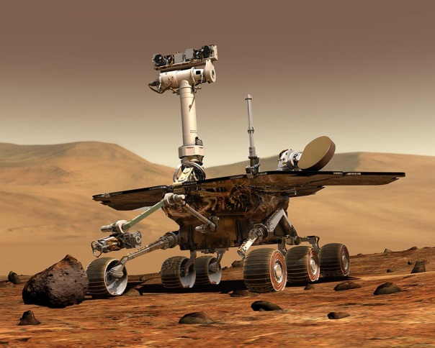
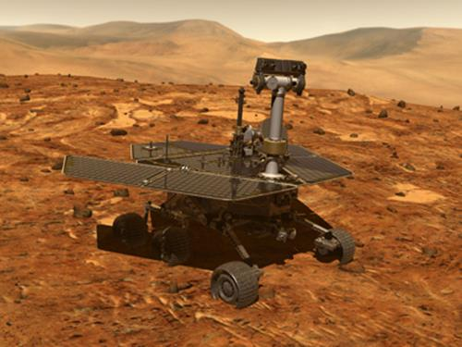
Example: Mars Exploration Rover
Direct remote control is not possible
It takes 10 minutes to send a message from Earth to Mars
Not possible to predict with sufficient accuracy what the robot will encounter in its environment
The robot needs to operate autonomously!

Slide 7
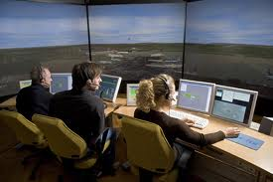

Example: Air Traffic Control
Air traffic Control: e.g., OASIS
Optimal Aircraft Sequencing using Intelligent Scheduling
Aids traffic control for incoming flights
Each plane represented by an agent
Negotiation among the agents determines the order of landing
Notes:
developed for Sydney's Kingsford Smith airport

Slide 8
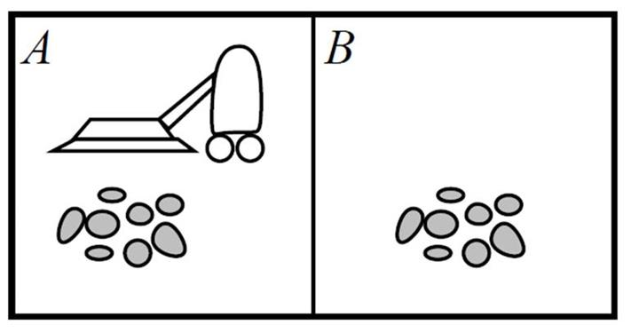
Vacuum-cleaner world
Percepts: location and contents, e.g., [A,Dirty]
Actions: Left, Right, Suck, NoOp

Slide 9
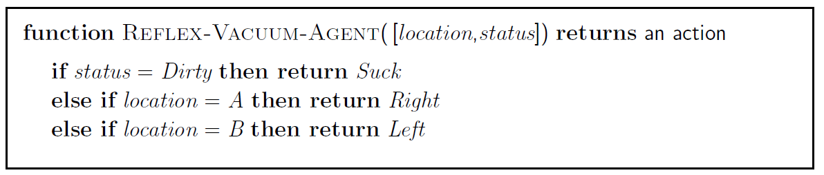
A vacuum-cleaner agent
Percept Sequence | Action
[A, Clean] | Right
[A, Dirty] | Suck
[B, Clean] | Left
[B, Dirty] | Suck
[A, Clean], [A, Clean] | Right
[A, Clean], [A, Dirty] | Suck

Slide 10
A vacuum-cleaner agent
Percept Sequence | Action
[A, Clean] | Right
[A, Dirty] | Suck
[B, Clean] | Left
[B, Dirty] | Suck
[A, Clean], [A, Clean] | Right
[A, Clean], [A, Dirty] | Suck
What is the right function?
Can it be implemented in a small agent program?

Slide 11
Rational agents
An agent should strive to "do the right thing", based on what it can perceive and the actions it can perform
The right action is the one that will cause the agent to be most successful
Performance measure: An objective criterion for success of an agent's behavior
Performance measure of a vacuum-cleaner agent:
amount of dirt cleaned up
cleanness of the environment
amount of time taken
amount of electricity consumed
amount of noise generated, etc.

Slide 12
Rational agents
Rational Agent: For each possible percept sequence, a rational agent should select an action that is expected to maximise its performance measure, given the evidence provided by the percept sequence and whatever built-in knowledge the agent has

Slide 13
Rational agents
Rationality is distinct from omniscience (all-knowing with infinite knowledge)
Agents can perform actions in order to modify future percepts so as to obtain useful information
information gathering, exploration
An agent is autonomous if its behavior is determined by its own experience (with ability to learn and adapt)
A rational agent is autonomous

Slide 14
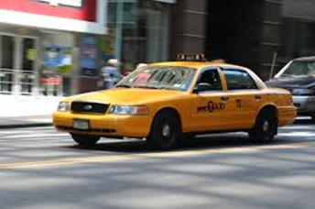
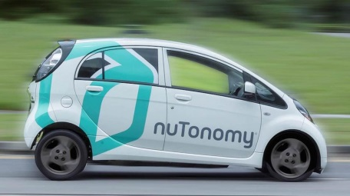
PEAS
PEAS: Performance measure, Environment, Actuators, Sensors
First specify the setting for intelligent agent design
Consider, the task of designing an automated taxi driver
Performance measure: Safe, fast, legal, comfortable trip, maximize profits
Environment: Roads, other traffic, pedestrians, customers
Actuators: Steering wheel, accelerator, brake, signal, horn
Sensors: Cameras, sonar, speedometer, GPS, odometer, engine sensors, keyboard
Notes:
odometer or odograph is an instrument for measuring the distance travelled by a vehicle

Slide 15
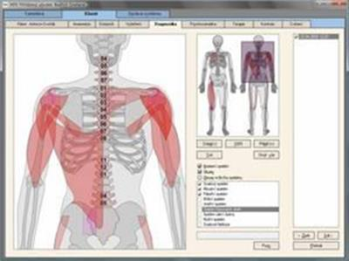
PEAS
Agent: Medical diagnosis system
Performance measure: Healthy patient, minimize costs, lawsuits
Environment: Patient, hospital, staff
Actuators: Screen display (questions, tests, diagnoses, treatments, referrals)
Sensors: Keyboard (entry of symptoms, findings, patient's answers)

Slide 16
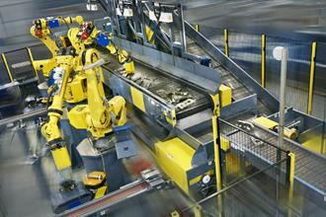
PEAS
Agent: Part-picking robot
Performance measure: Percentage of parts in correct bins
Environment: Conveyor belt with parts, bins
Actuators: Jointed arm and hand
Sensors: Camera, joint angle sensors

Slide 17
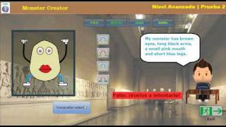
PEAS
Agent: Interactive English tutor
Performance measure: Maximize student's score on test
Environment: Set of students
Actuators: Screen display (exercises, suggestions, corrections)
Sensors: Keyboard

Slide 18
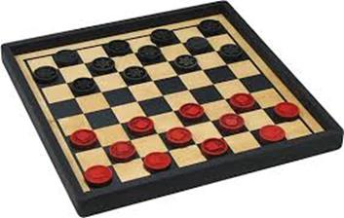
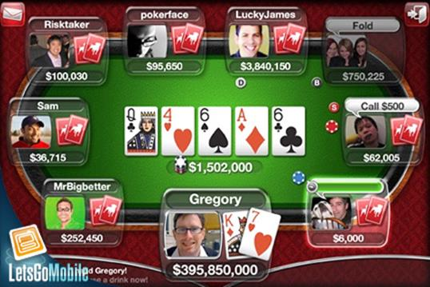
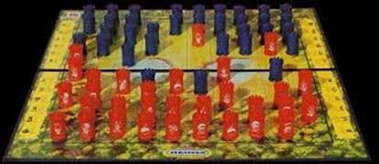
Environment types
Fully observable (vs. partially observable): An agent's sensors give it access to the complete state of the environment at each point in time
Fully observable Partially observable

Slide 19
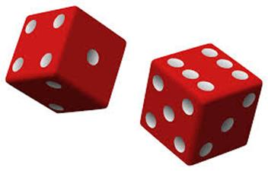
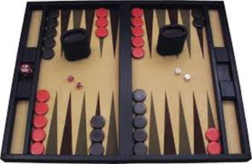
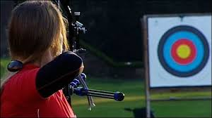
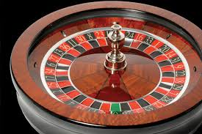
Environment types
Deterministic (vs. stochastic): The next state of the environment is completely determined by the current state and the action executed by the agent.
Deterministic Stochastic

Slide 20
Environment Types
Episodic (vs. sequential): The agent's experience is divided into atomic "episodes" (each episode consists of the agent perceiving and then performing a single action), and the choice of action in each episode depends only on the episode itself
Static (vs. dynamic): The environment is unchanged while an agent is deliberating.
The environment is semidynamic if the environment itself does not change with the passage of time but the agent's performance score does

Slide 21
Environment types
Discrete (vs. continuous): A limited number of distinct, clearly defined percepts and actions
Single agent (vs. multiagent): An agent operating by itself in an environment

Slide 22
Environment types
Task
Environment
Observable
Agents
Deterministic
Episodic
Static
Discrete
Cross
word Puzzle
Fully
Single
Deterministic
Sequential
Static
Discrete
Chess with a clock
Fully
Multi
Deterministic
Sequential
Semi
Discrete
Poker
Partially
Multi
Stochastic
Sequential
Static
Discrete
Backgammon
Fully
Multi
Stochastic
Sequential
Static
Discrete
Taxi Driving
Partially
Multi
Stochastic
Sequential
Dynamic
Continuous
Medical
Diagnosis
Partially
Single/
Multi
Stochastic
Sequential
Dynamic
Continuous
Image Analysis
Fully
Single
Deterministic
Episodic
Semi
Continuous
Part
Episodic
Continuous
-
Picking
Robot
Partially
Single
Stochastic
Dynamic
Refinery Controller
Partially
Single
Stochastic
Sequential
Dynamic
Continuous
Interactive English
Partially
Multi
Stochastic
Sequential
Dynamic
Discrete
Tutor
Notes:
Medical diagonosis system can be argued as multi-agent, when patients, staff is involved
Playing a chess tournament can be regarded episodic, on a high level, a the performance in one game is not influenced played in the previous game

Slide 23
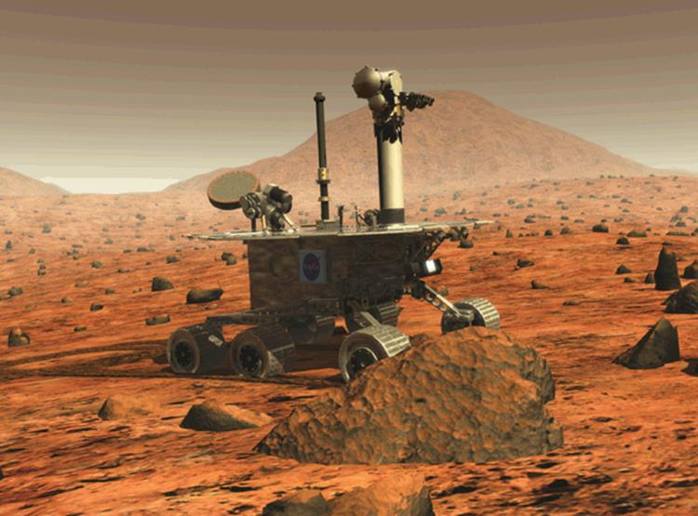
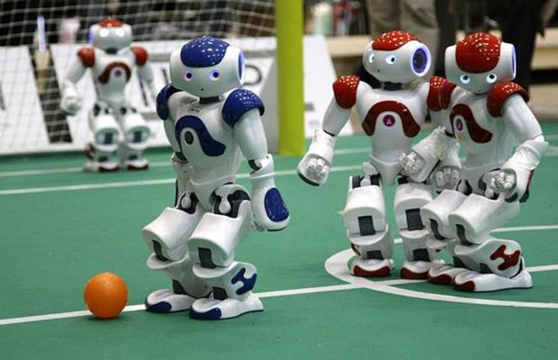
Exercise: Environment types
Task Environment | Observable | Agents | Deterministic | Episodic | Static | Discrete
Mars Exploration Agent
Chess without a clock
Internet Shopping
Soccer

Slide 24
Environment types
Task Environment | Observable | Agents | Deterministic | Episodic | Static | Discrete
Mars Exploration Agent | Partially | Single | Stochastic | Sequential | Dynamic | Continuous
Chess without a clock | Fully | Multi | Deterministic | Sequential | Static | Discrete
Internet Shopping | Partially | Single (except for auctions) | Partly | Sequential | Dynamic | Discrete
Soccer | Partially | Multi | Stochastic | Sequential | Dynamic | Continuous

Slide 25

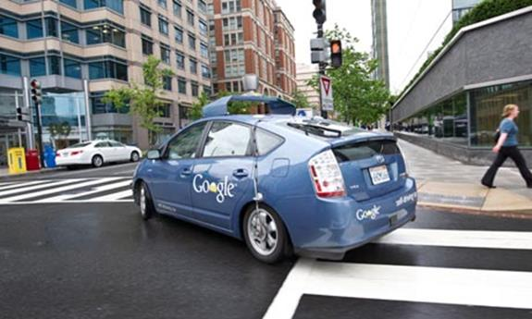
Environment types
The environment type largely determines the agent design
The real world is (of course) partially observable, stochastic, sequential, dynamic, continuous, multi-agent

Slide 26

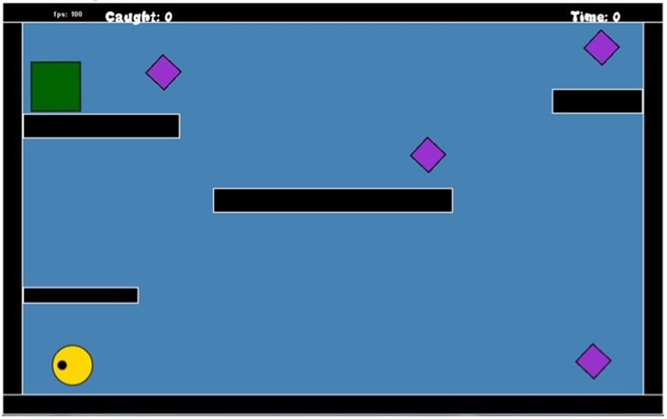
Environment types
Known (vs unknown) state of knowledge of the “law of physics” of the environment
Poker games are partially observable, but the environment is known (i.e., the rules)
A video game can be fully observable, but you may have no idea what the result of the action until you try

Slide 27
The structure of Agents

Slide 28
Agent functions and programs
An agent is completely specified by the agent function mapping percept sequences to actions
One agent function (for a small equivalence class) is rational
Aim: find a way to implement the rational agent function concisely

Slide 29
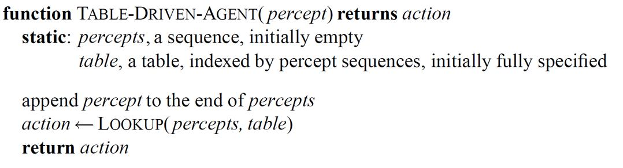
Table-lookup agent
Drawbacks:
Huge table
Take a long time to build the table
No autonomy
Even with learning, need a long time to learn the table entries
Percept Sequence | Action
[A, Clean] | Right
[A, Dirty] | Suck
[B, Clean] | Left
[B, Dirty] | Suck
[A, Clean], [A, Clean] | Right
[A, Clean], [A, Dirty] | Suck

Slide 30
Agent types
Four basic types in order of increasing generality:
Simple reflex agents
Model-based reflex agents
Goal-based agents
Utility-based agents
All can be turned into learning agents

Slide 31
Example: A vacuum-cleaner agent

Slide 32
Simple reflex agents
Select action on the basis of only the current percept
E.g. the vacuum‐agent
Large reduction in possible percept/action situations
Implemented through condition‐action (if-then) rules
If dirty then suck

Slide 33
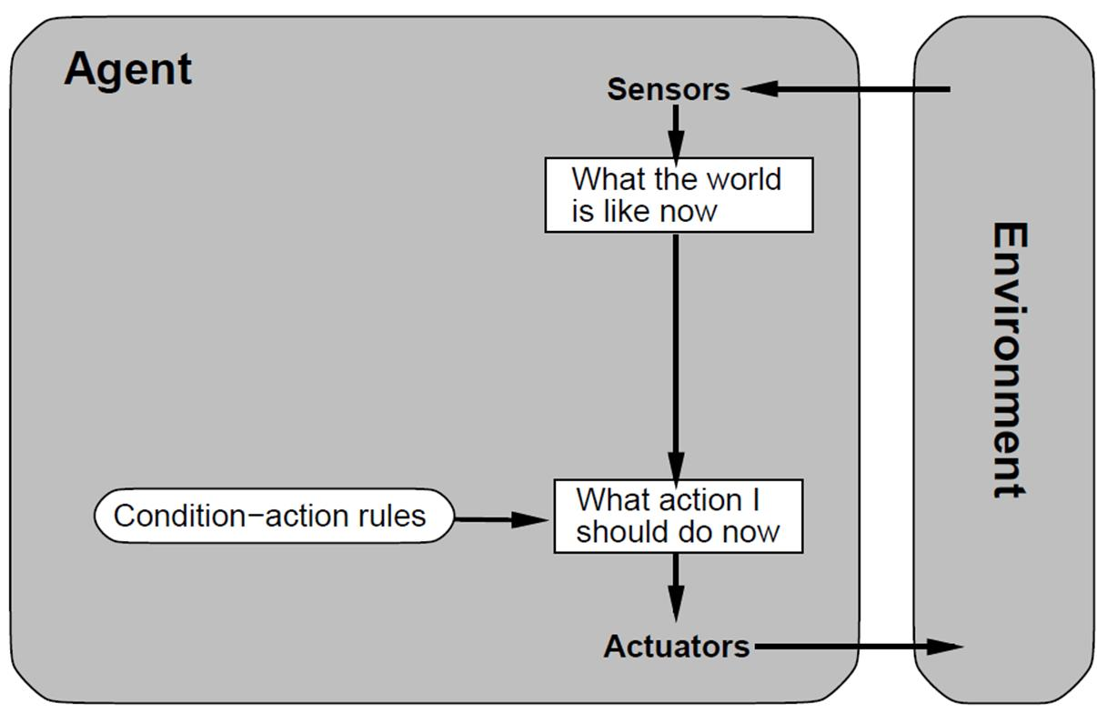
Simple reflex agents

Slide 34
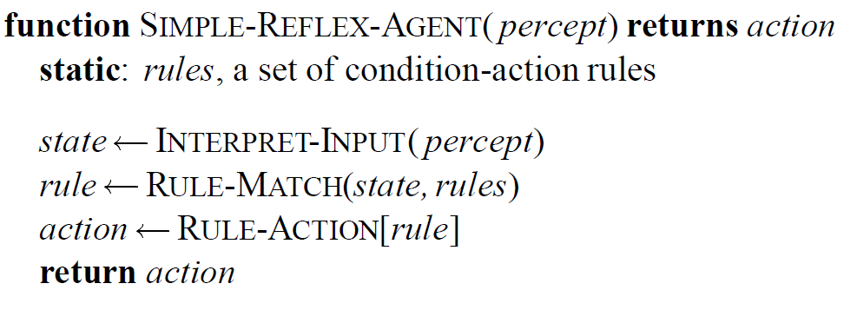
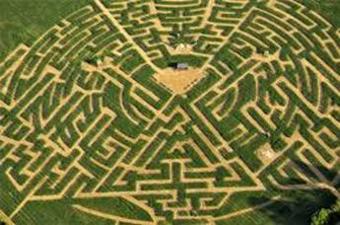
Simple reflex agents
Will only work if the environment is fully observable otherwise infinite loops may occur
Randomization may help

Slide 35
Model-based reflex agents
To tackle partially observable environments
Maintain internal state
Over time update state using world knowledge
How does the world change
How do actions affect world
⇒ Model of the World

Slide 36
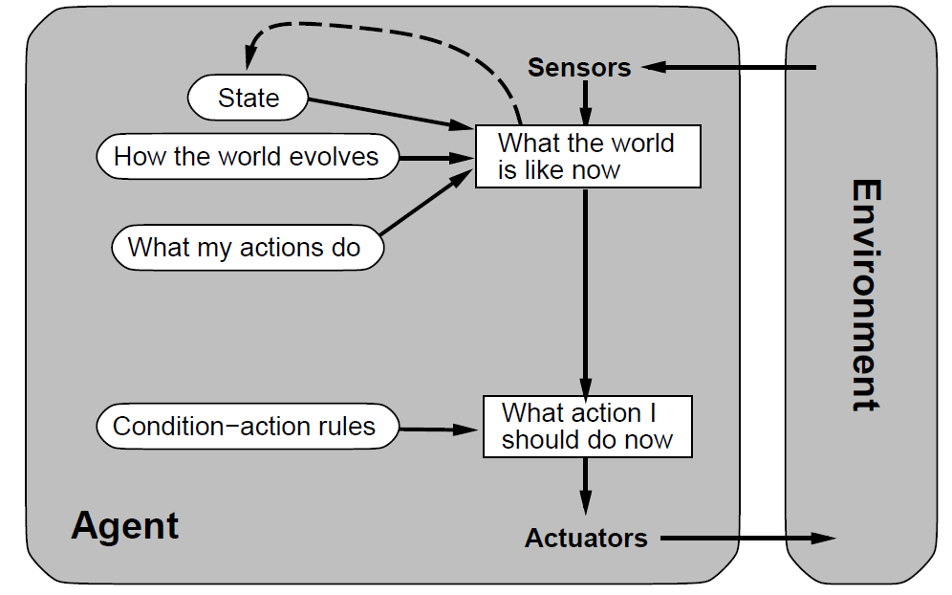
Model-based reflex agents

Slide 37
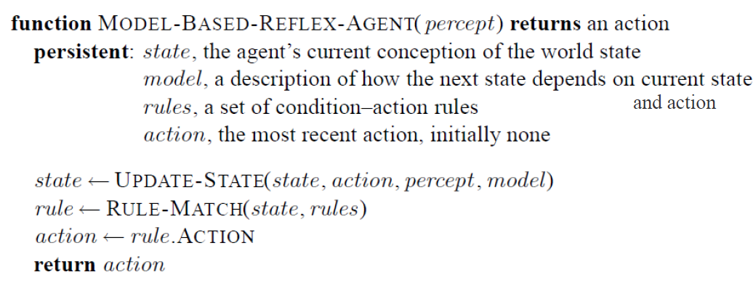
Model-based reflex agents

Slide 38
Goal-based agents
The agent needs a goal to know which situations are desirable
More tricky when long sequences of actions are required to find the goal
Typically investigated in search and planning research
Major difference: future is taken into account
Is more flexible since goals are represented explicitly and can be changed

Slide 39
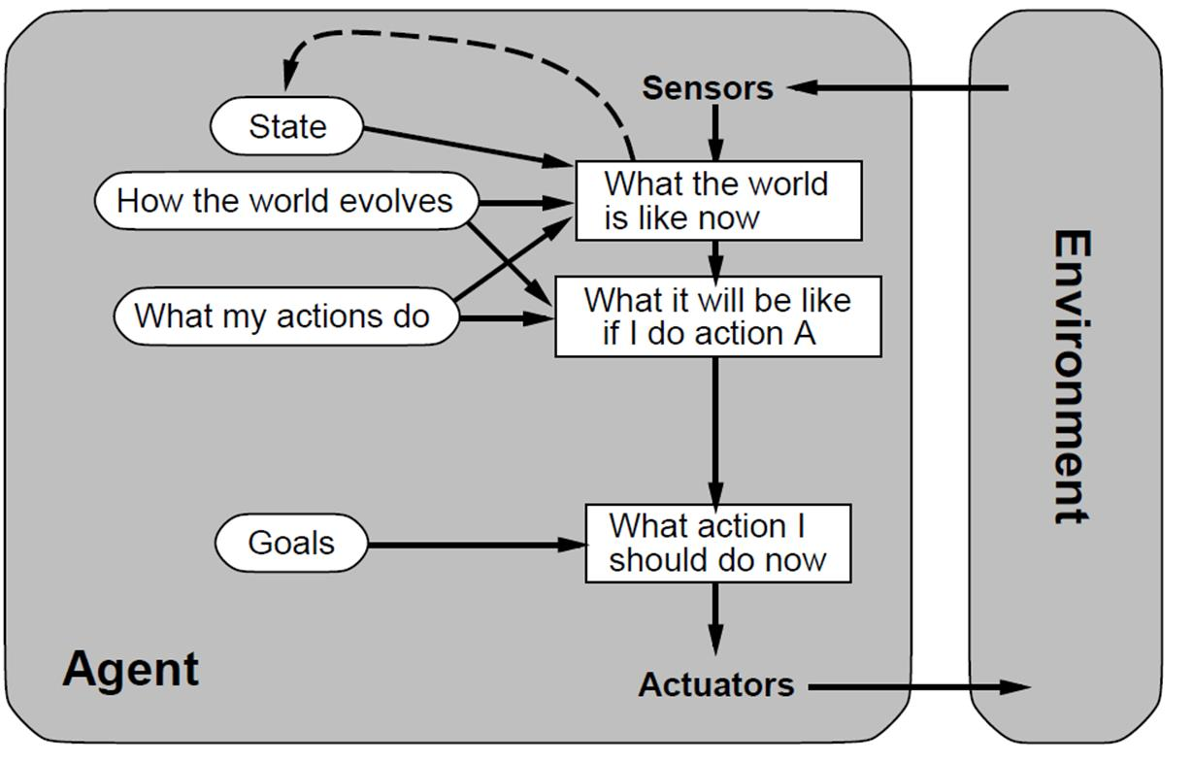
Goal-based agents

Slide 40
Utility-based agents
Certain goals can be reached in different ways
Some are better, have a higher utility
Utility function maps a (sequence of) state(s) onto a real number
Improves on goals:
Selecting between conflicting goals
Select appropriately between several goals based on likelihood of success

Slide 41
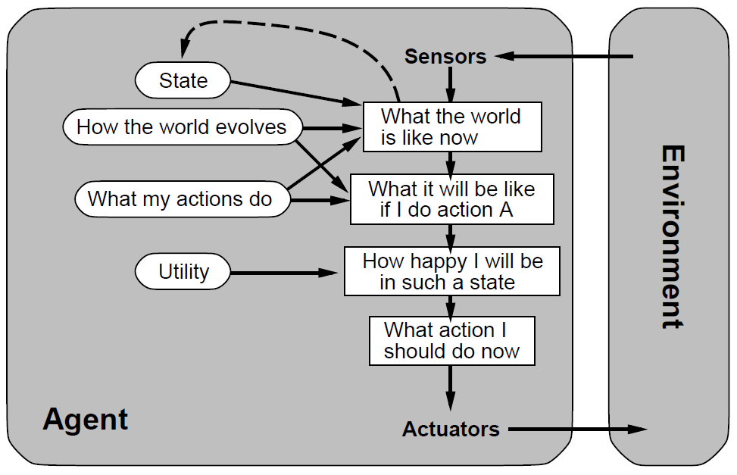
Utility-based agents

Slide 42
Exam check list
What is an agent?
When is it rational? autonomous?
PEAS
Describing environments
observable? deterministic? episodic? static? discrete? single-agent?
Basic agent architectures
reflex, model-based reflex, goal-based, utility-based

Slide 43
Agents at DKE
Reasoning Techniques
Intelligent Systems
Autonomous Robotic Systems
Foundations of Agents
Multi-agent Systems

Slide 44
Homework
Read Chapter 2 (except 2.4.7)
Watch https://www.youtube.com/watch?v=vF_-ob9vseM
Questions:
If you were designing a successful mouse agent, what sensors and action functions would it need?

